Slide 1
An Improved Correlation Instrument for Measurements of Noise in Amplifiers and Transistors
Andrew Fox
Mentor: Dazhen Gu

Slide 2
What are we measuring?
Noise Parameters in the 1-2 GHz regime
Noise Figure (NF): the amount of noise that an active device adds to a signal (in dB)
Minimum Noise Figure (F_{min}): lowest achievable NF for a device
Reflection coefficient (Γ_{opt}): optimal reflectance for lowest noise (complex)
Noise Resistance (R_{n}): how sensitive the NF is to deviations from the optimal reflectance
NF is equivalent to Noise Temperature (NT)
Accurate measurements are vital for low-noise amplifiers
More difficult to maintain precision as NF gets smaller
Notes:
talk about motivation of communication devices on this slide

Slide 3
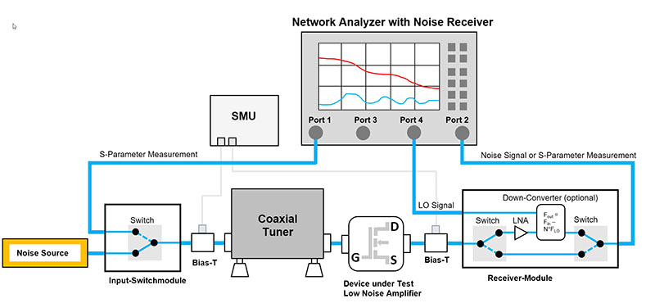
Source-Pull Method
BSW Testsystems & Consulting AG. Impedance Adaptations / Noise Parameter.
Send a known amount of noise with varying source impedance into amplifier, analyzer measures noise figure/noise power
Tuners are mechanical, and often large
At best fraction of a decibel precision
Notes:
Talk about deficits of mechanical: can break, have to sweep all of the impedances (slow). also have to be so large
about half a decibel

Slide 4
Correlator Method
Directly samples noise waves emanating from input (Ch 1) and output (Ch 2) ports of the DUT
Uses an Analog to Digital converter (ADC) and digital signal processing to convert time series data to frequency series and find power density
Processed data used to calculate noise parameters (and NF)

Slide 5
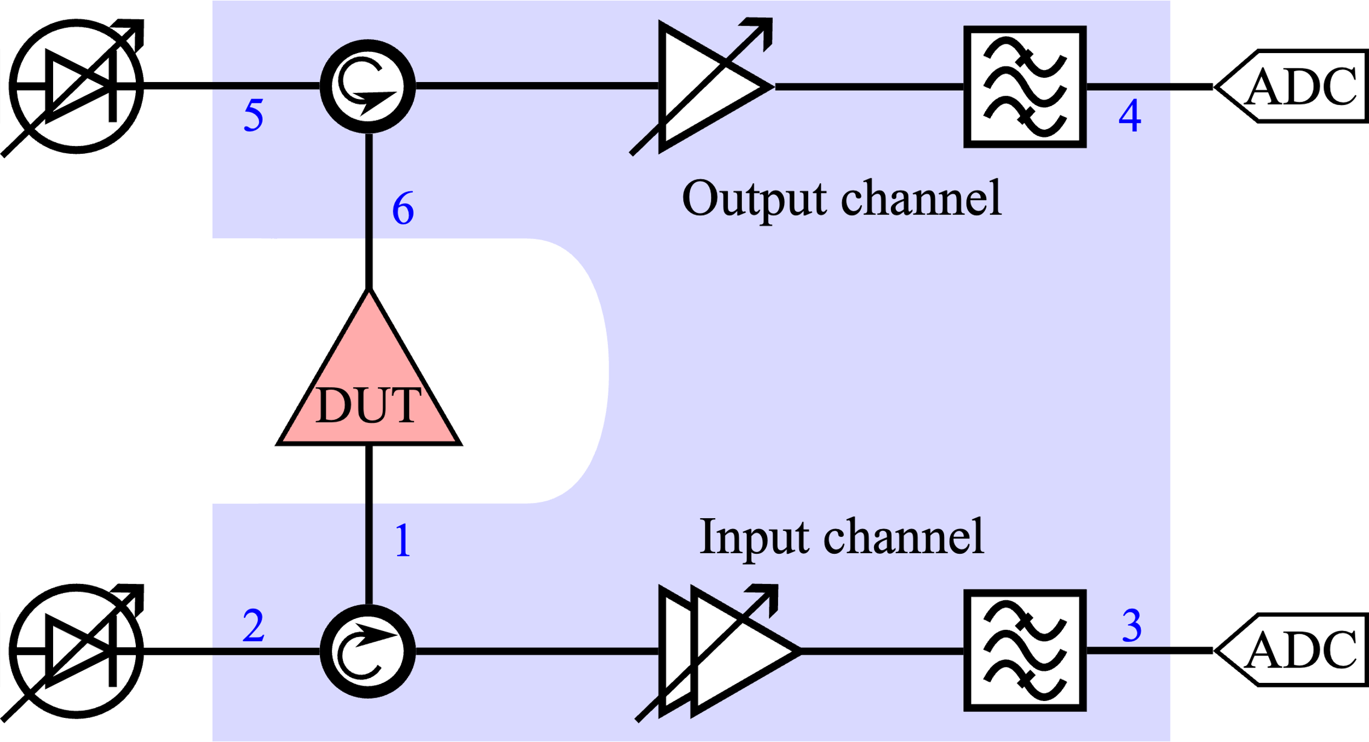
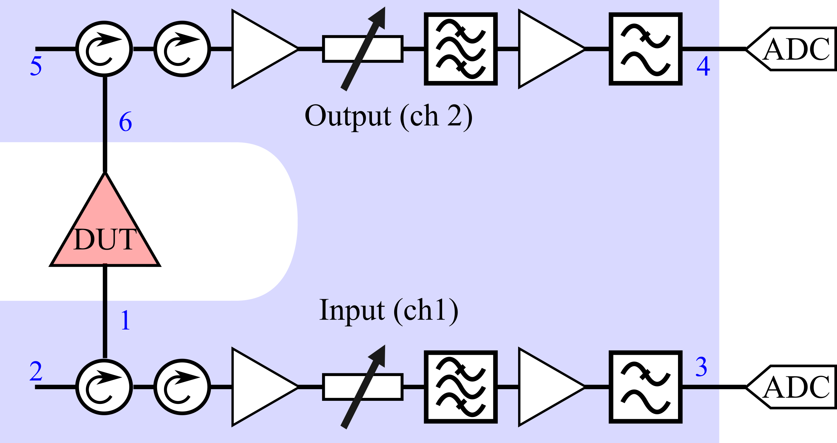
Correlator Method - Components
Notes:
adapted from a previous publication, get away from variable noise due to precision

Slide 6
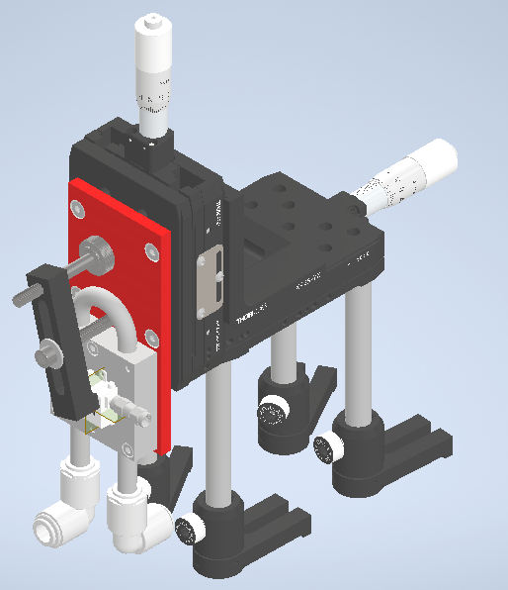
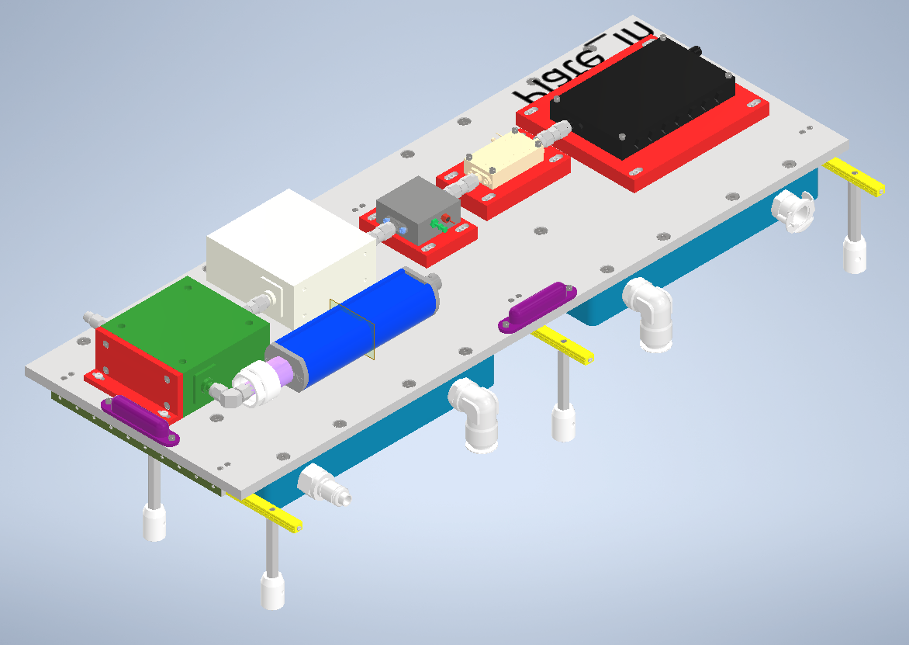
Redesigned Structures
CH 1+2
DUT
Greatly reduced size ( < 50% original size)
Added adjustable attenuator, second stage amplifier
Smaller structure
.5” movement in two axes
Notes:
Say I

Slide 7
CAD Design
Finalized Design
Ensures movement in three axes for DUT of different sizes
.5”
2.5”
.5”
2.5”

Slide 8
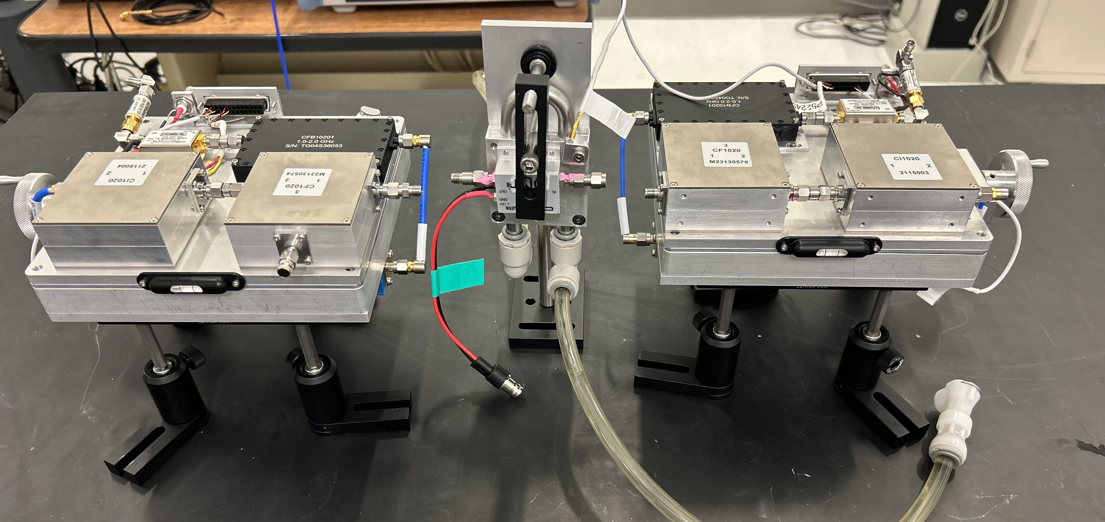
Assembled Device
Parts ordered, delivered, and assembled without incident or delay
S-parameters measured to help calibrate device

Slide 9
Measurement Steps
S-parameters – find the gain of both channels
Continuous Wave (CW) – precisely find gain vs frequency
Noise Diode (ND) – send a noisy signal with known NT through
DUT – Measure the DUT to extract noise parameters

Slide 10
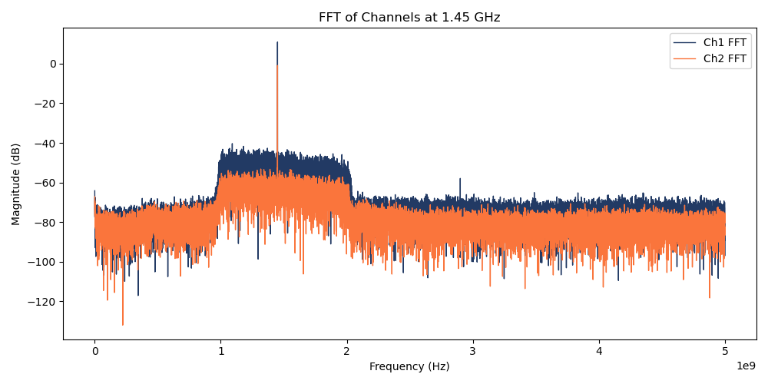
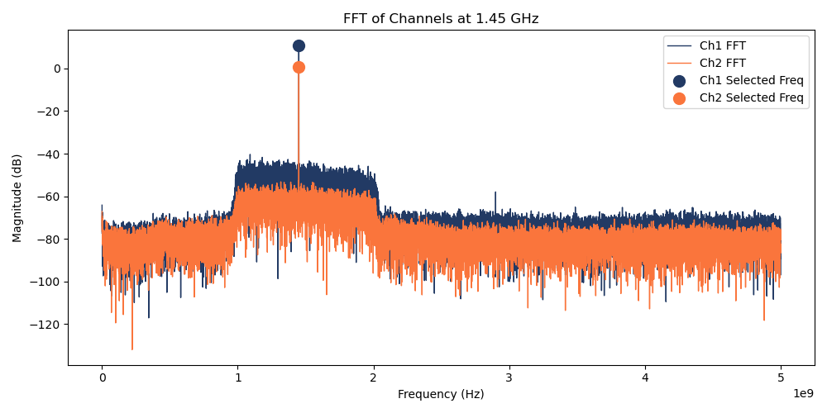
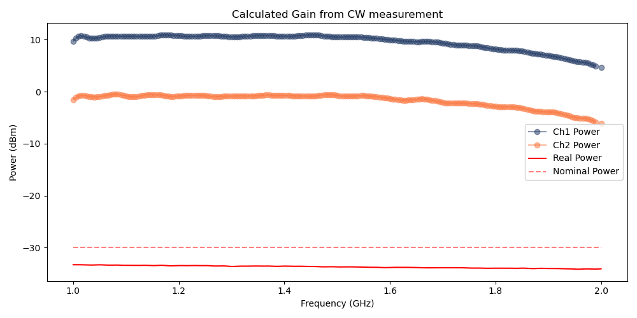
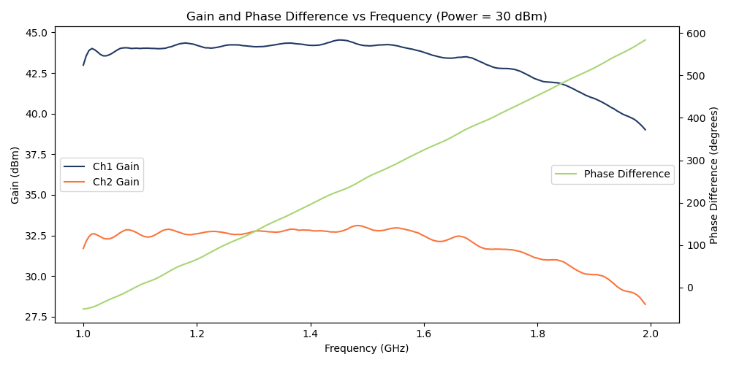

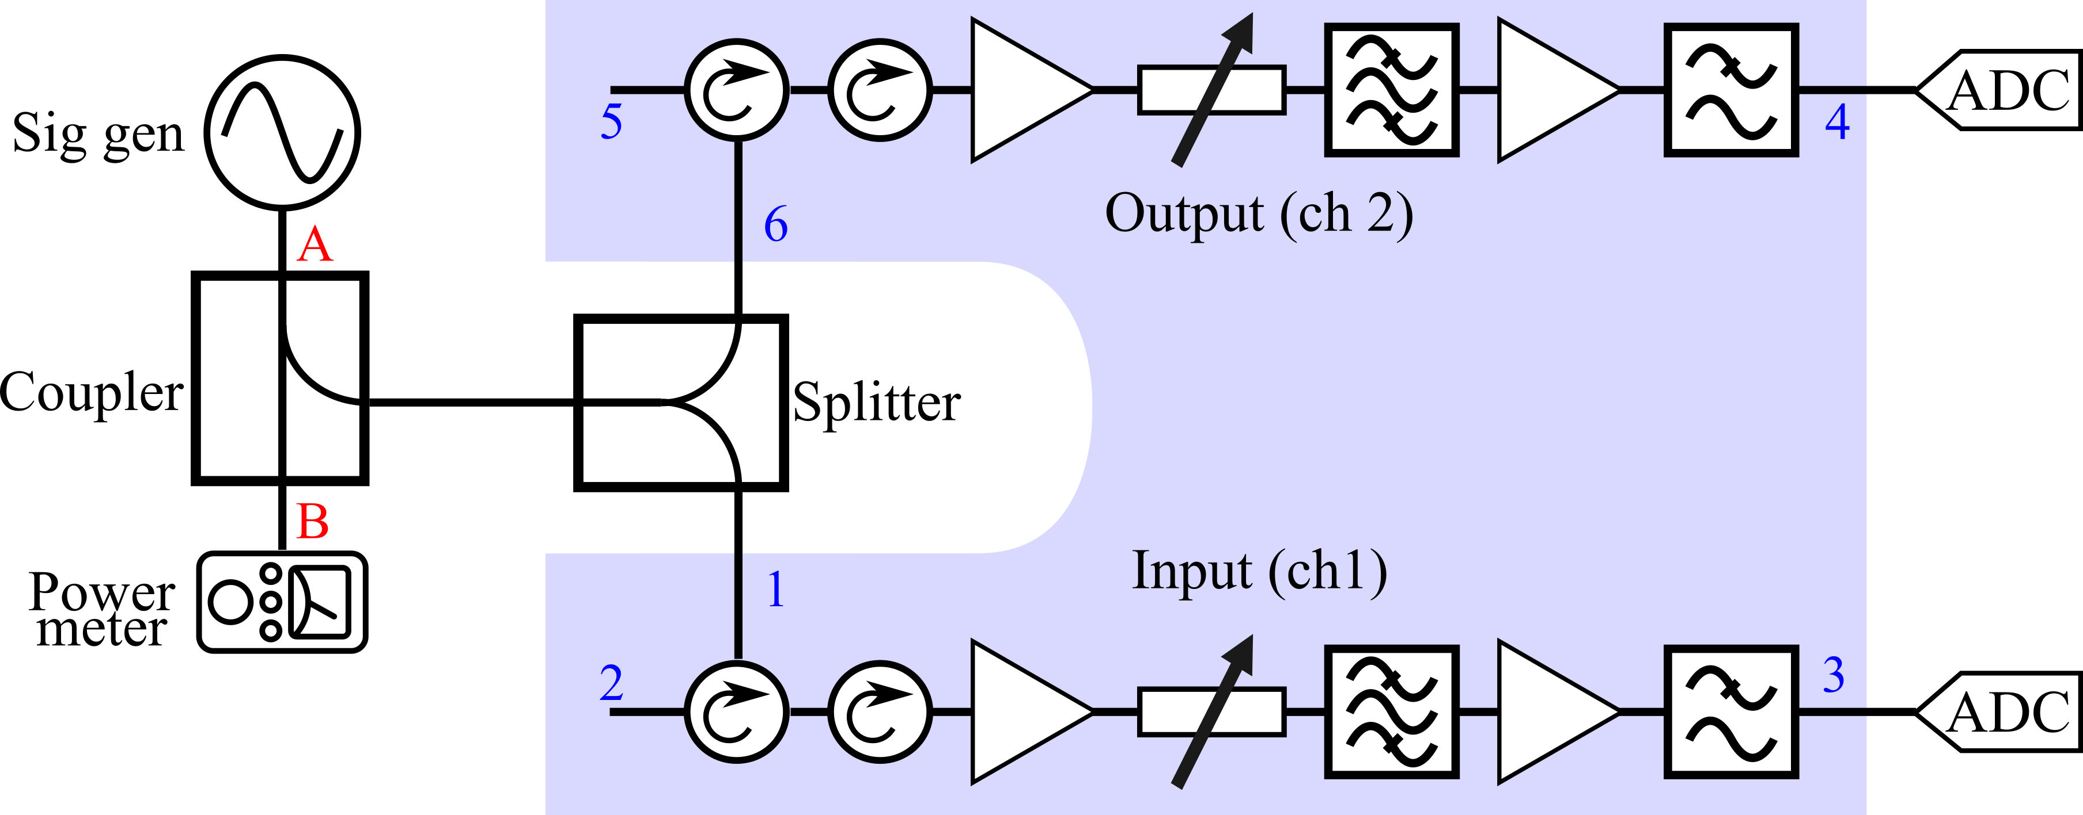
CW Tone Processing
Send known tones every 5 MHz from 1-2 GHz
With processing steps, can find the gain and phase difference
Repeatability across different powers

Slide 11
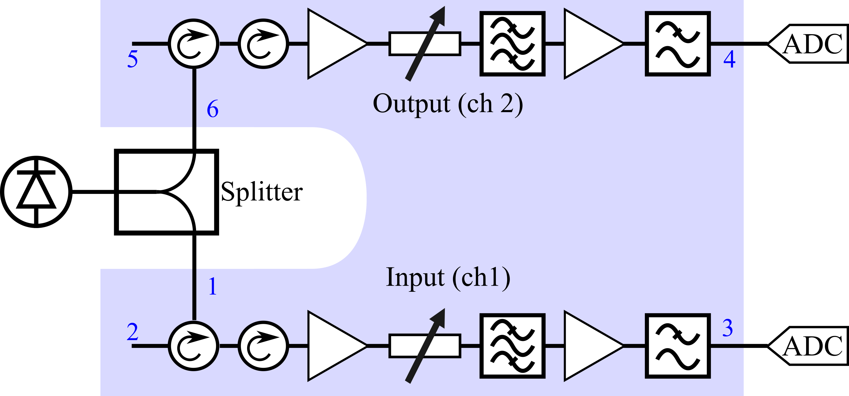
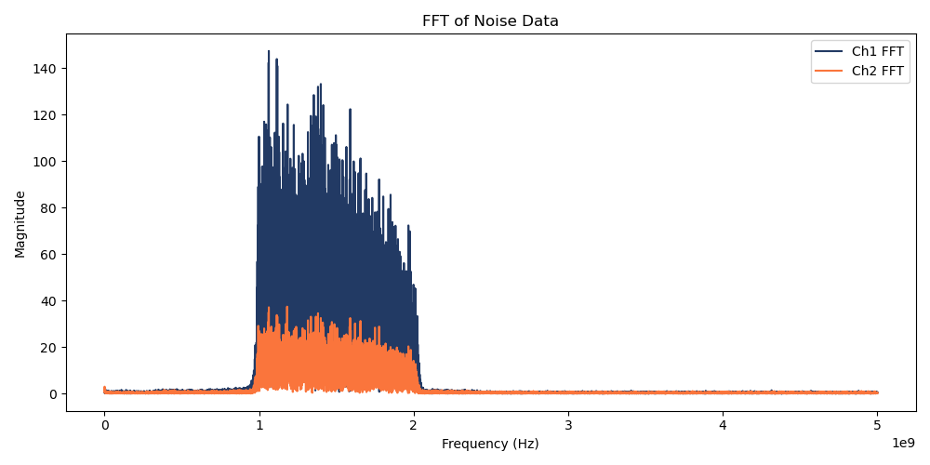
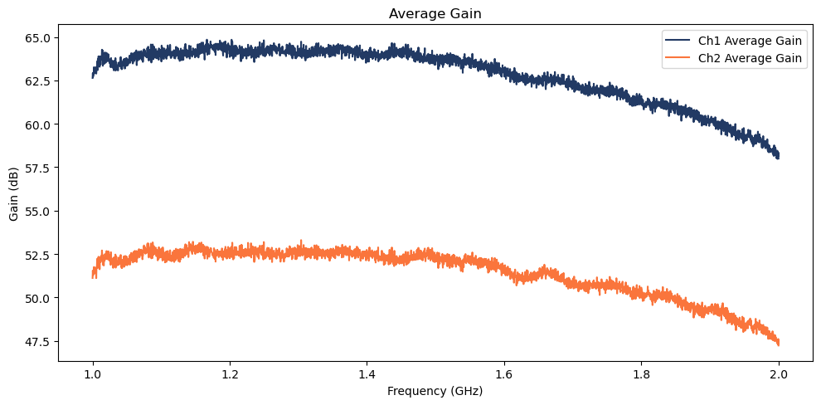
ND Data Processing
Pilot signal – we know the noise emitted from it, and can find the gain of that noise
Still used for calibration
Very similar gain as found via CW

Slide 12
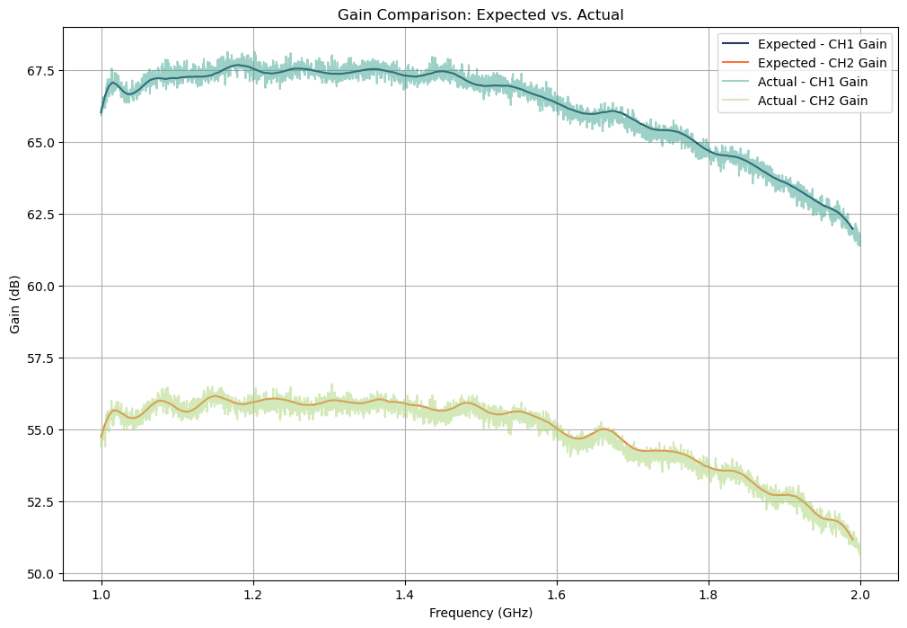
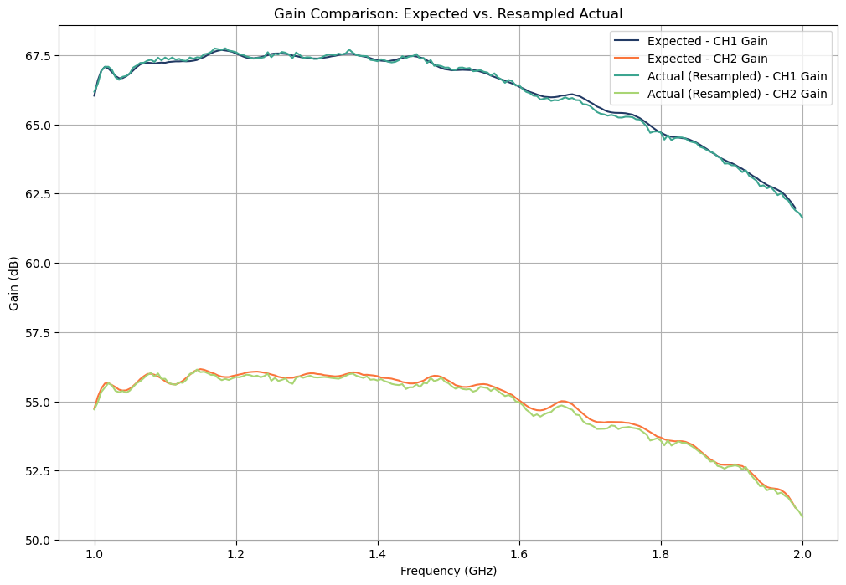
Calibration Comparison
Very similar results (RMS error of .21 and .23 dB)
Some minor corrections still needed

Slide 13
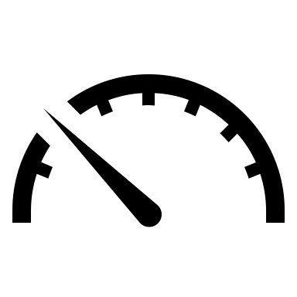



Conclusion
Correlator vs Source-Pull:
Reasonable preliminary output
Hoping for better
Design & Assembly:
50% original size
Improved dynamic range
Calibration:
CW tones + noise diode
Reproducible results
Future Steps:
Measure DUT
Known Gain -> measure NF

Slide 14
Thank You
Special thanks to:
Dazhen Gu
Xifeng Lu
Dan Kuester
Paritosh Manurkar
CTL Div. 675

Slide 16
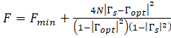
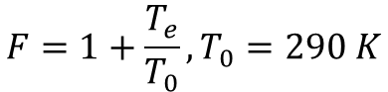
Noise Figure & Noise Temp
$$F=1+\frac{T_{e}}{T_{0}}, T_{0}=290 K$$

Slide 17
CW Calibration
CW Tones sent from 1-2 GHz every 5 MHz

Slide 18
Noise Signal Calibration

Slide 19
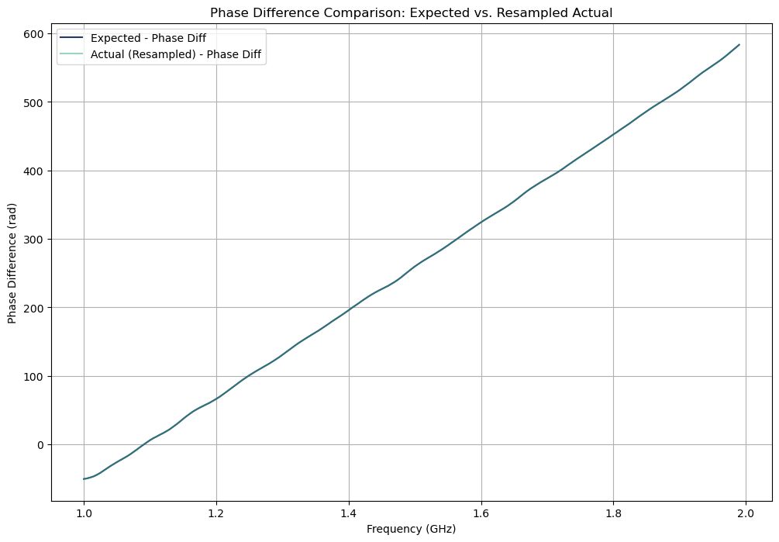
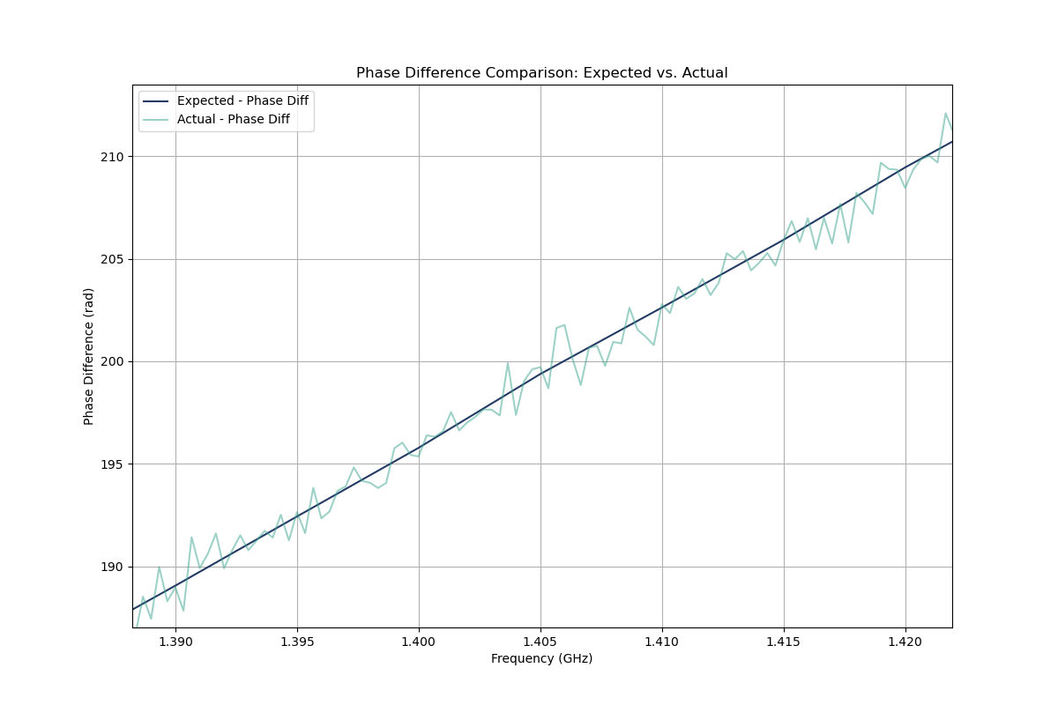
Phase Comparison
Phases of the two are virtually the same

Slide 20
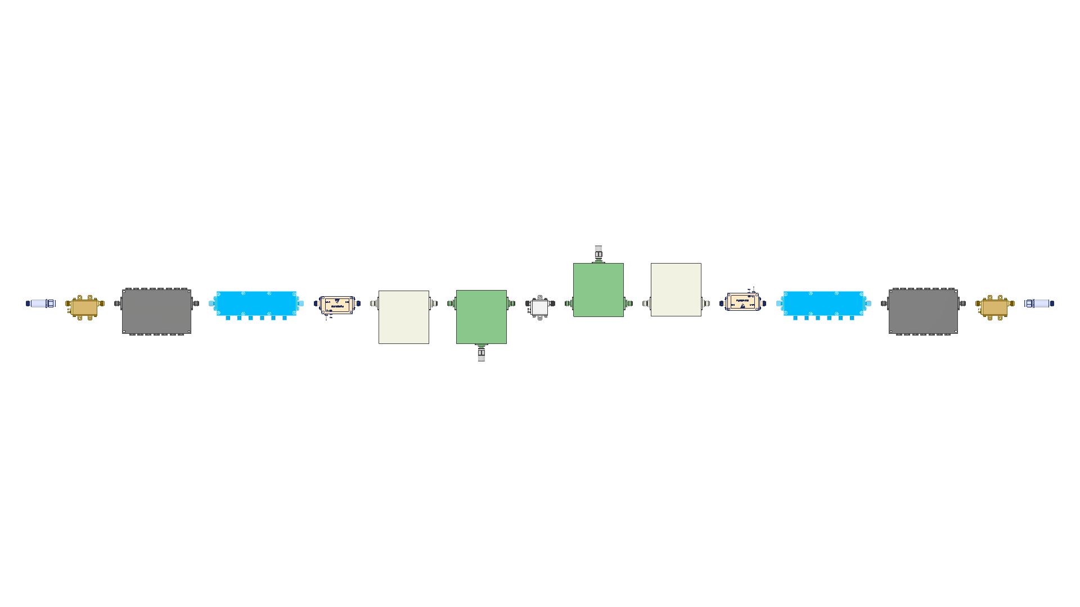
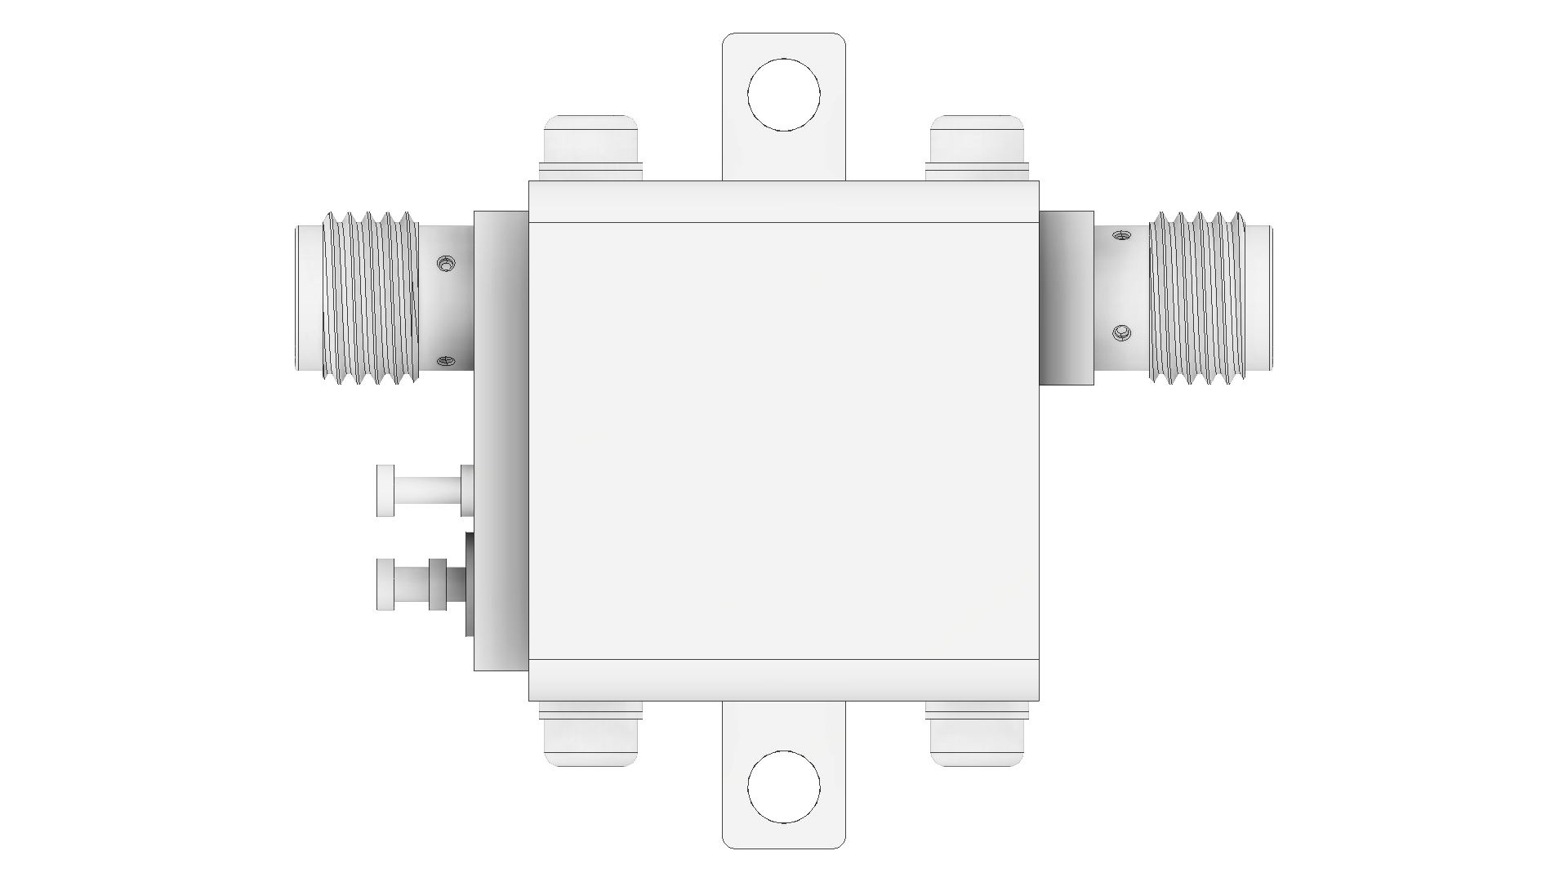
Components
Channel 2 (Out)
Channel 1 (In)
Both channels are read by an ADC

Slide 21
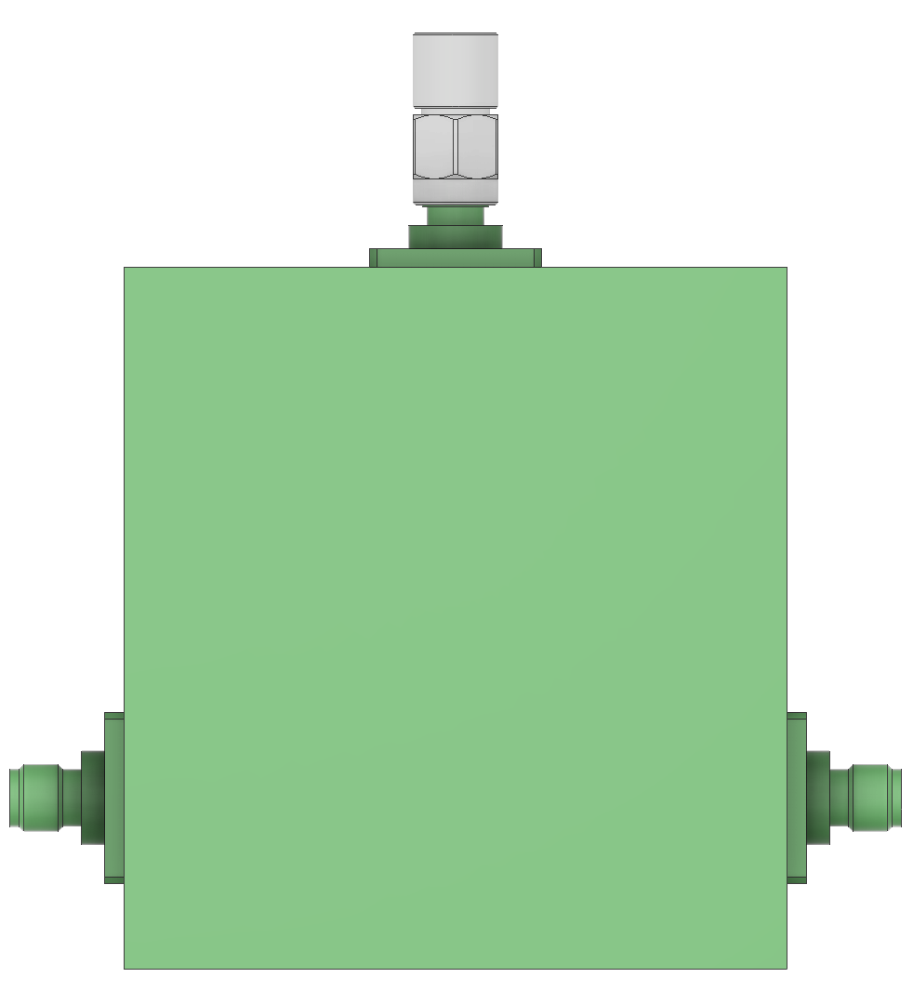
Device Under Test (DUT)
Arbitrary low-noise transistor or amplifier

Slide 22

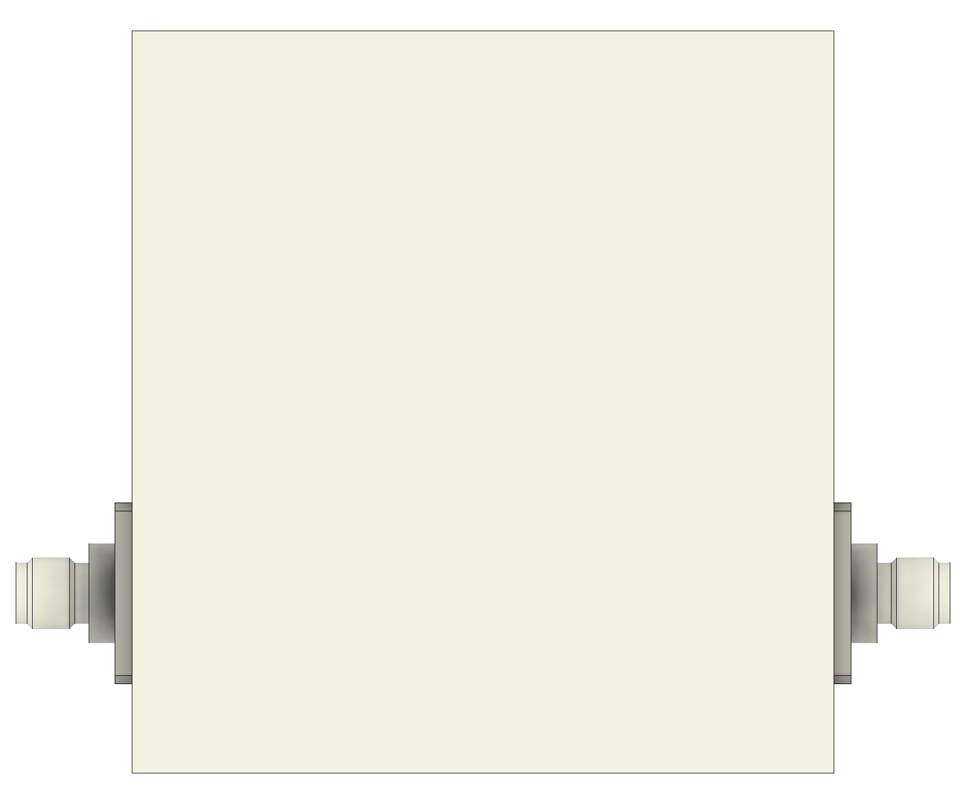
Circulator
CF1020
17 dB isolation

Slide 23
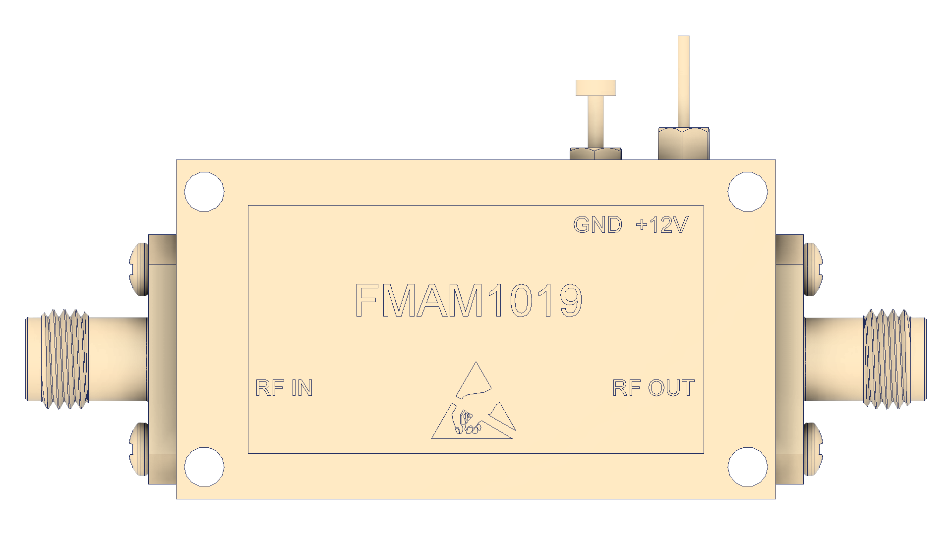
Isolator
CI1020
17 dB Isolation

Slide 24
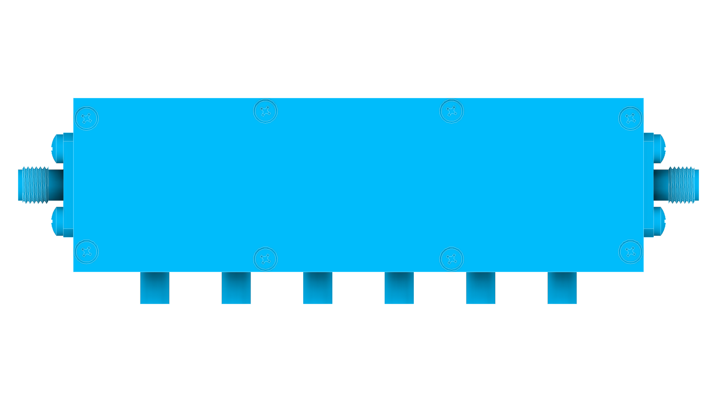
Low Noise Amplifier
FMAM 1019
40dB gain
.8 dB NF
11dBm output power

Slide 25
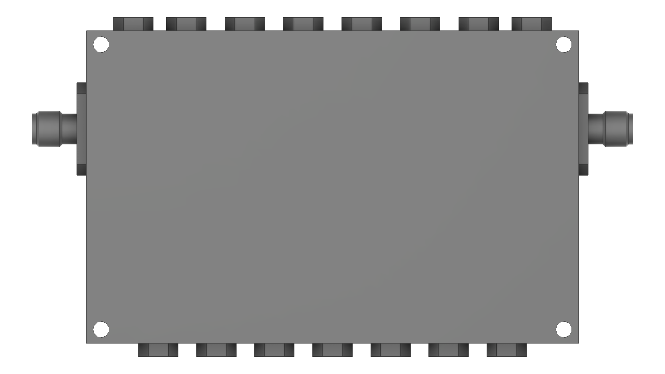
Attenuator
PE70A1049S
0-41dB Attenuation
Allows for improved dynamic range

Slide 26
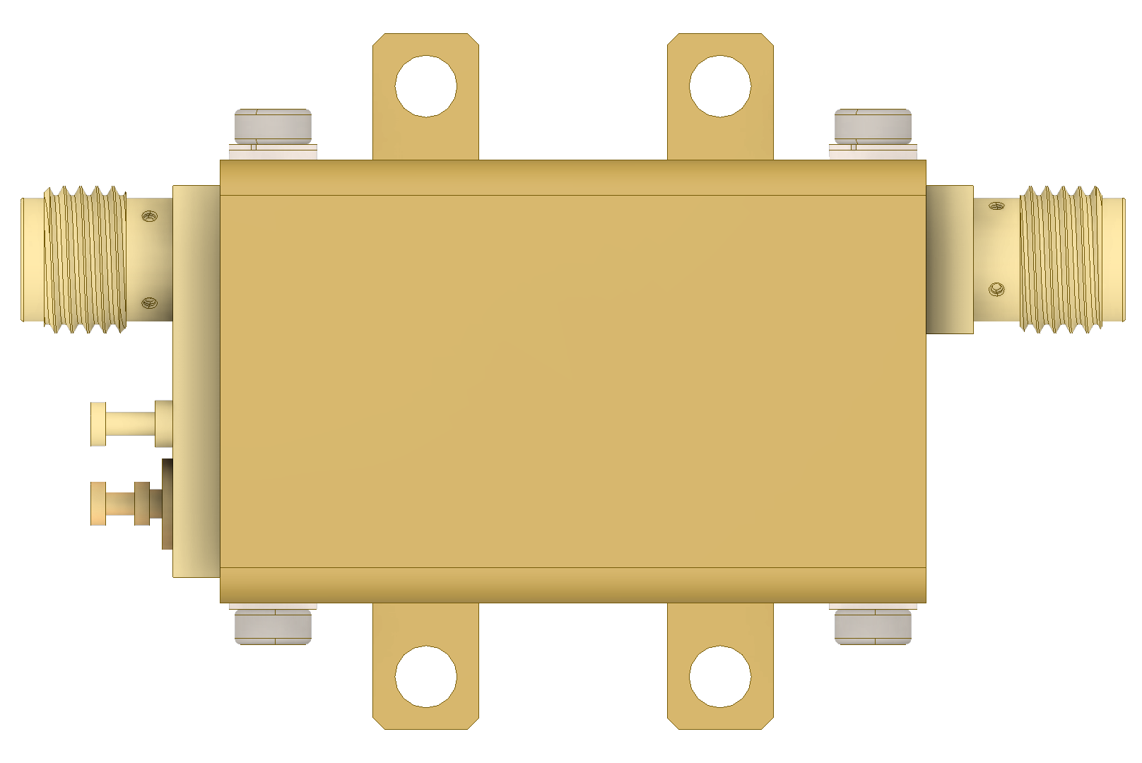
Band Pass Filter
CFB 10201
Only allows 1-2 Ghz, 50 dB attenuation otherwise

Slide 27
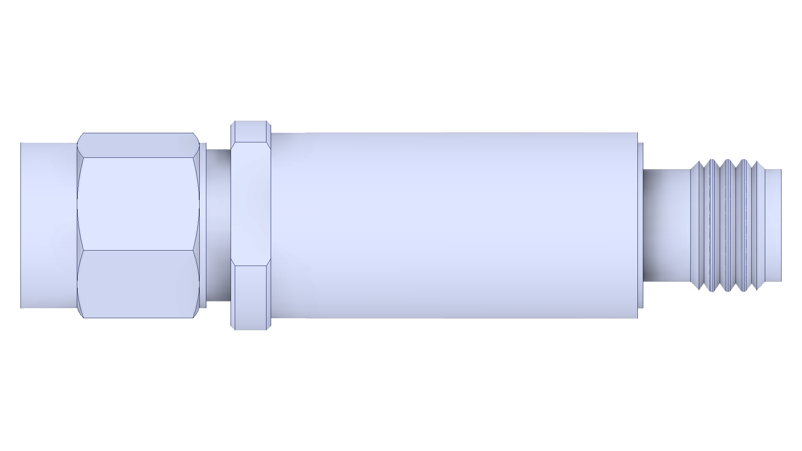
Medium Power Amplifier
ZX60-2534MA+
~ 40 dB gain
2.6 DB NF
18 dBm output power

Slide 28
Low Pass Filter
VLFG-2000+
~42 dB attenuation above 2GHz

